Slide 1

Global Electronics Retailer: Commercial Performance Audit
Strategic Insights & Recommendations for Sustainable Growth
David Sebastian Aritonang
July 2026

Slide 2
Table of Contents
Introduction & Business Objectives
Data Overview & Preparation
Customer Geography
Product Portfolio
Revenue & Seasonality Trends
Operational Efficiency & Channel Performance
Strategic Recommendations
Conclusion

Slide 3


Introduction & Business Objectives
Business Context
Key Business Questions
As operations scale across international markets, identifying core revenue drivers and evaluating supply chain health is critical. This commercial audit aims to uncover purchasing patterns, operational bottlenecks, and channel effectiveness to drive the upcoming fiscal year's growth strategy.
What is the current composition of our product portfolio, and where are our primary customer bases located?
Are there identifiable seasonal patterns impacting revenue and order volume?
How is our logistics network performing over time regarding delivery speeds?
Is there a measurable difference in the Average Order Value (AOV) between In-Store and Online sales channels?

Slide 4
Data Overview & Preparation
Data Processing (ETL)
Dimensionality & Tech Stack
Rigorous data cleaning and validation were executed to ensure a high-fidelity analysis of historical global retail transactions.
Optimized data granularity to focus on macro-level business trends that inform strategic decisions at the executive level.
Data Type Casting: Converted raw string data into exact datetime formats to enable precise time-series analysis.
Dimensionality Reduction: Categorized granular age data into distinct macro-demographic buckets (Youth, Adult, Senior).
Metric Engineering: Formulated custom metrics such as Average Order Value (AOV) by aggregating total revenue against distinct orders.
Tech Stack Utilization: Leveraged Google BigQuery for robust SQL processing, Microsoft Excel for rapid validation, and Tableau for interactive visualizations.

Slide 5

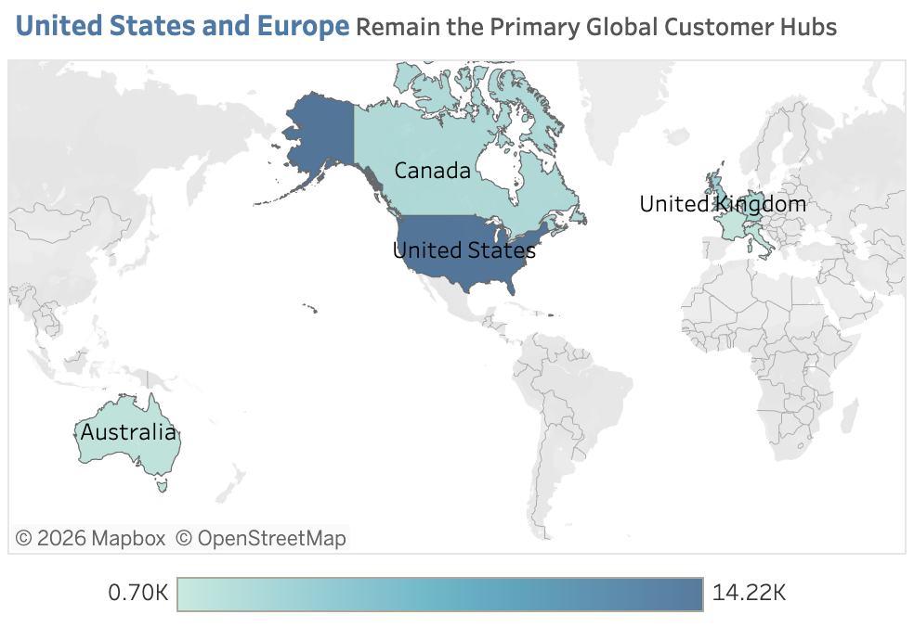
Customer Geography: The Western Anchor
Primary Global Customer Hubs
The geographic distribution of orders reveals a highly concentrated consumer base, essential for targeted marketing and logistics scaling.
Market Dominance: The United States acts as the absolute anchor for the business, generating the highest volume of traffic (reaching up to 14.22K total orders).
Secondary Hubs: Europe, specifically the United Kingdom, acts as the strongest secondary regional hub.
Untapped Potential: Emerging markets like Australia show a growing footprint but currently lack deep market penetration compared to Western hubs.

Slide 6
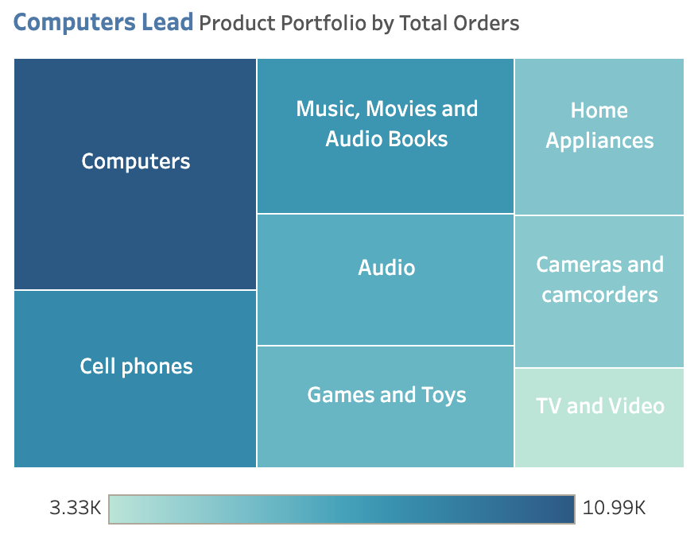
Product Portfolio Dominance
Computers Lead Total Orders
Analyzing the product mix is crucial to understanding where revenue dependencies lie and identifying opportunities for diversification.
Market Dominance: North America drives the highest volume, with the United States acting as the absolute anchor (14.22K orders), strongly supported by Canada.
Secondary Hubs: Europe, specifically the United Kingdom, acts as the strongest secondary regional hub outside of North America.
Untapped Potential: While Western markets dominate, APAC regions like Australia show a growing footprint but still lack deep market penetration.

Slide 7
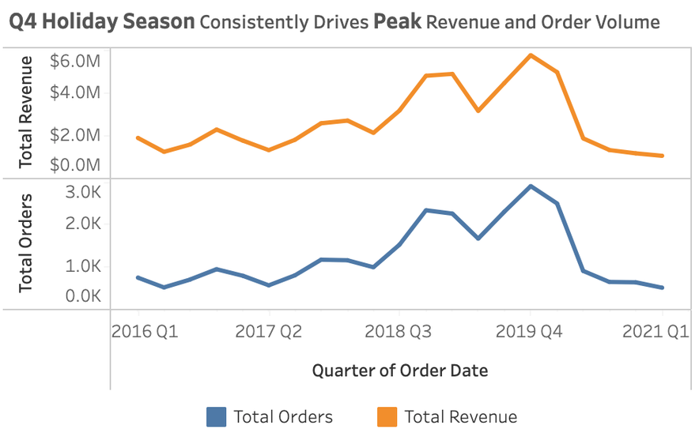
Revenue & Seasonality Trends
The Q4 Holiday Dependency
Historical trend analysis highlights a critical dependency on end-of-year sales, exposing mid-year cash flow vulnerabilities.
Predictable Surges: There is an aggressive spike in order volume (>3.0K) and total revenue (~$6.0M) during the fourth quarter of every recorded year.
Post-Holiday Drop-off: The momentum sharply declines moving into Q1 and Q2, reflecting a reliance on the Holiday Season.
Commercial Takeaway: Marketing and supply chain resources are overly stressed during a narrow window, leaving the rest of the year under-optimized.

Slide 8

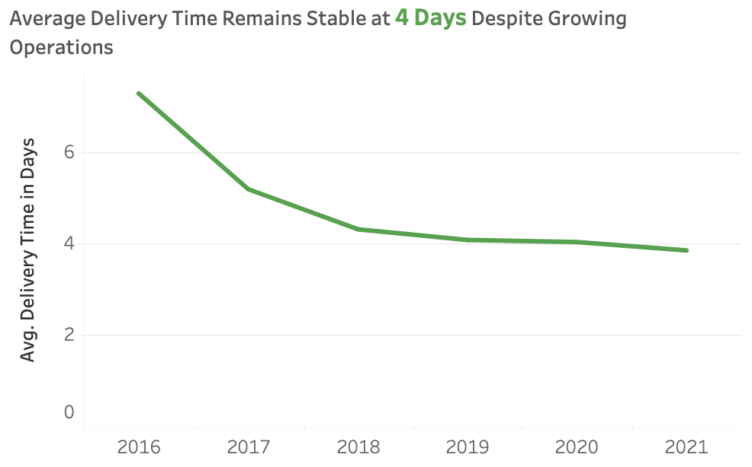
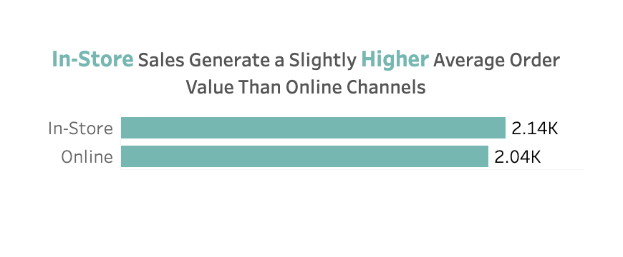
Operational Efficiency & Channel Performance
Logistics Optimization
Channel Value Generation
Delivery efficiency has successfully stabilized at a precise 4-day average. The supply chain has proven highly resilient despite growing global volume.
In-Store transactions consistently yield a higher Average Order Value ($2.14K) compared to Online ($2.04K), driven by physical cross-selling advantages.

Slide 9






Strategic Recommendations
Q4 Supply Chain Fortification
Closing the AOV Gap
Off-Peak Market Penetration
Given the reliance on Q4, logistics teams must secure maximum inventory allocation for Computers in US and EU distribution centers by late Q3 to mitigate holiday stock-outs.
Bridge the deficit between In-Store and Online channels by implementing dynamic bundle pricing algorithms at checkout, replicating the consultative in-store experience.
Flatten the sharp Q1/Q2 revenue drop-offs by initiating targeted promotional campaigns for mid-tier products during off-peak months, aimed at emerging segments.

Slide 10



Conclusions
Conclusion
This commercial audit confirms that the company's financial backbone is heavily concentrated in Computer sales within Western markets, driven almost exclusively by the Q4 holiday season.
Operationally, the logistics network is highly robust, successfully sustaining a 4-day delivery benchmark across the globe.
By leveraging this stable fulfillment infrastructure to push digital cross-selling and off-peak promotions, the business is well-positioned to evolve from seasonal spikes to sustained, year-round profitability.
By leveraging our stable fulfillment infrastructure to push digital cross-selling and off-peak promotions, the business is well-positioned to evolve from seasonal spikes to sustained, year-round profitability.
End of Presentation | Interactive Executive Dashboard Available on Tableau Public

Slide 11
Appendix & Resources
DATASET
https://docs.google.com/spreadsheets/d/1aDs0jMjC9sNaI0JgzZ1sJsPGH_xBfXezU3XYWsV78Bc/edit?usp=sharing
TABLEAU PUBLIC
https://public.tableau.com/views/GlobalElectronicsRetailerExecutiveCommercialDashboard/ExecutiveDashboard?:language=en-US&:sid=&:redirect=auth&:display_count=n&:origin=viz_share_link
GITHUB
https://github.com/davidsebastianart/global-electronics-retailer-audit

Slide 12
Thank You

